Slide 1
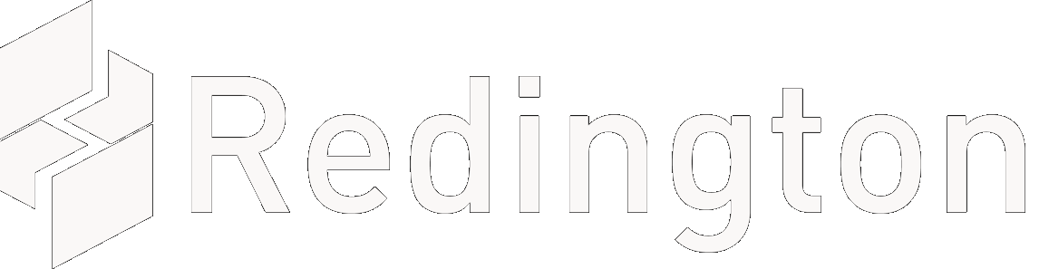

Azure Migrate & Modernize
Optimizing IT Infrastructure for Agility, Security, and Cost Efficiency

Slide 2
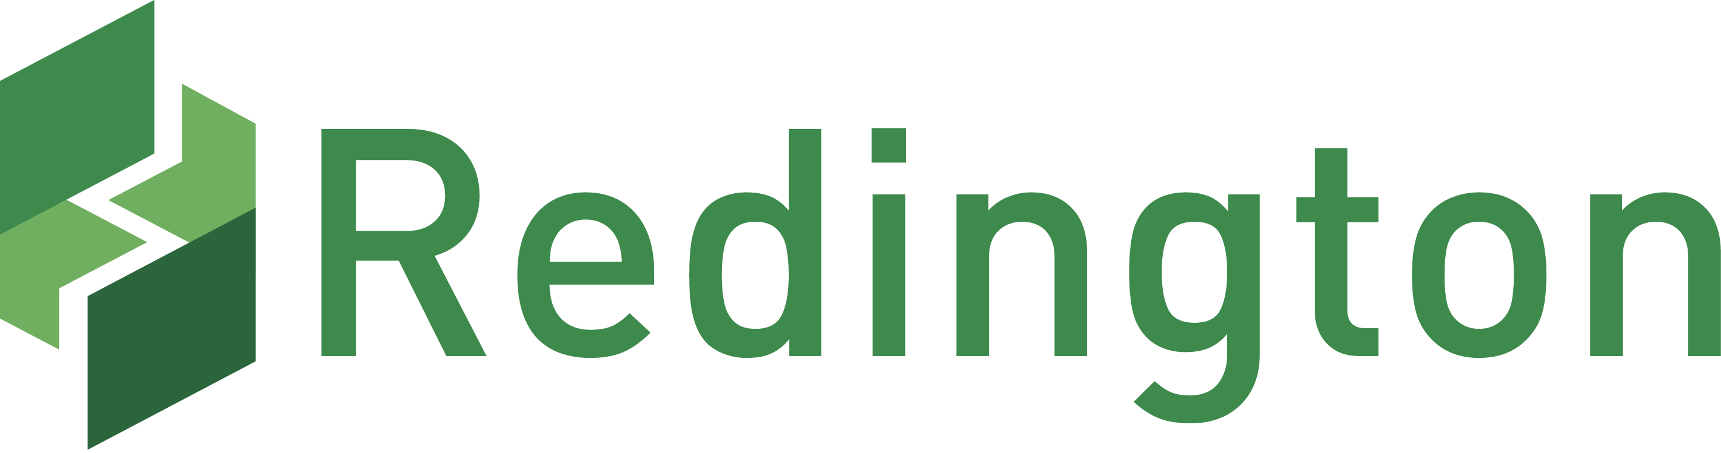
About Redington | Who we are ?
Redington has traversed an eventful and exciting journey to evolve from very humble beginnings into the company we are today. The incredible journey has seen us emerge from one brand, one product category, and one market into
290+
~$10 Billion
40+
International Brands in IT, Mobility, Cloud Solution & Services
Distribution & Supply Chain Solution Providers
Emerging Markets
We distribute products from over 40 leading manufacturers through our subsidiaries and service over 34,000 channel partners globally. The company is the second-largest distributor of IT products in India and the largest in the Middle East and Africa.
#2
#1
ISO 27001 & SOC 2
Enterprise Indirect solution Provider in India
Technology distributor in MEA
Security Complaince

Slide 3
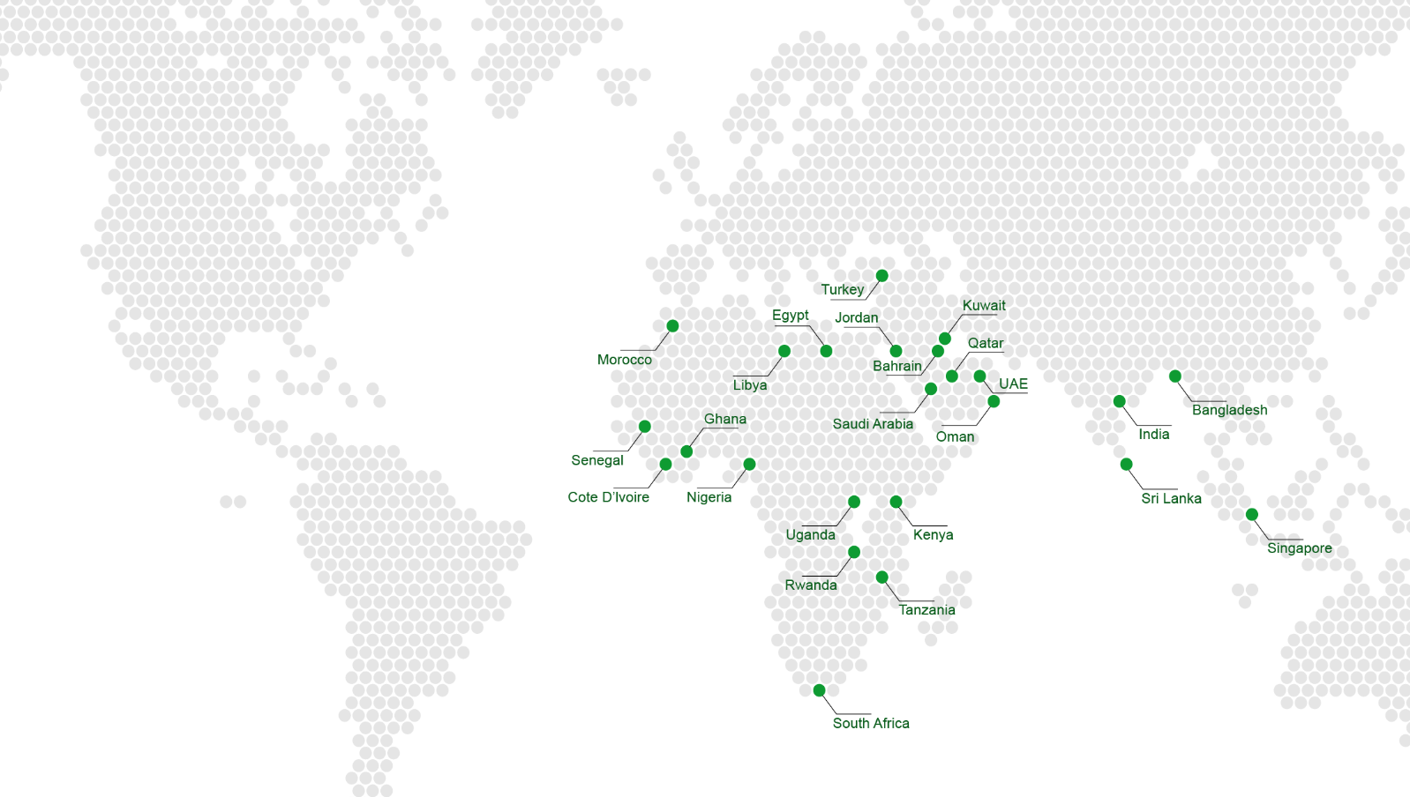
Global Footprint
40+
290+
Emerging Markets
International Brands

Slide 4

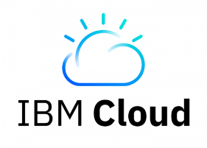
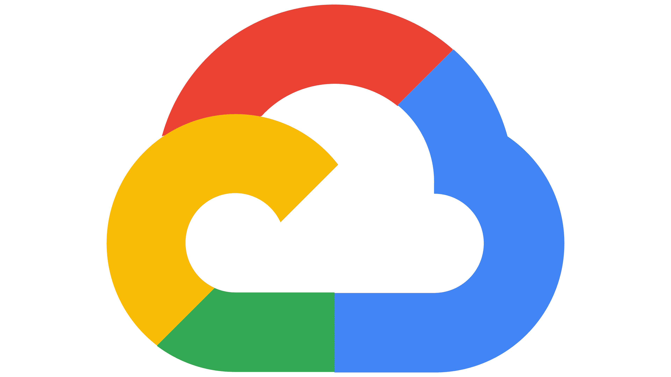
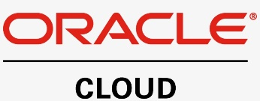



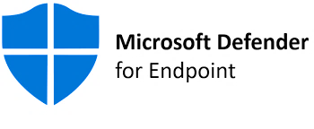
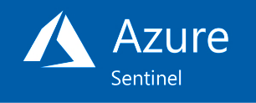
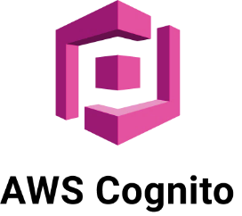



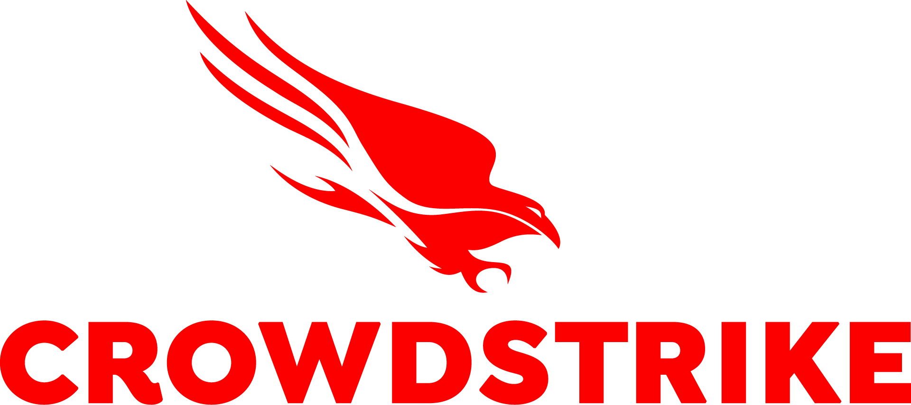

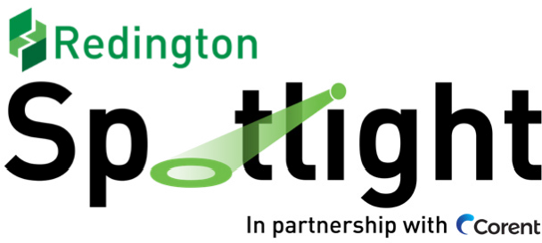

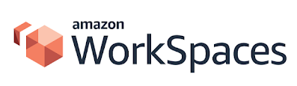
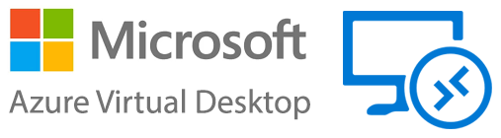

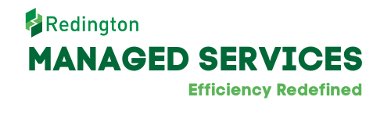



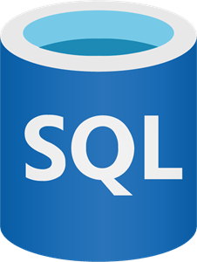


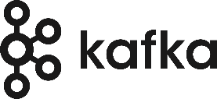
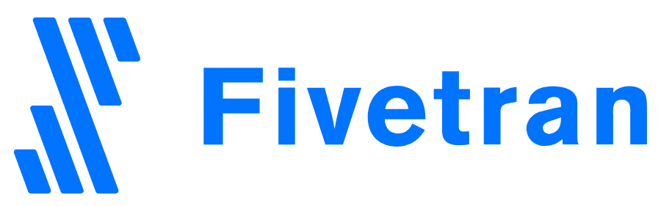

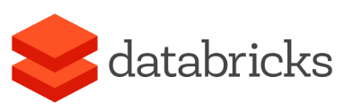


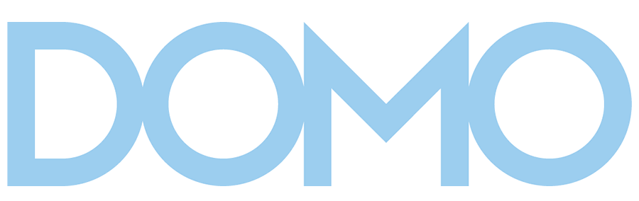






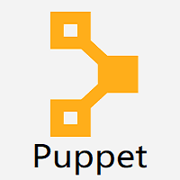


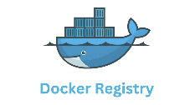


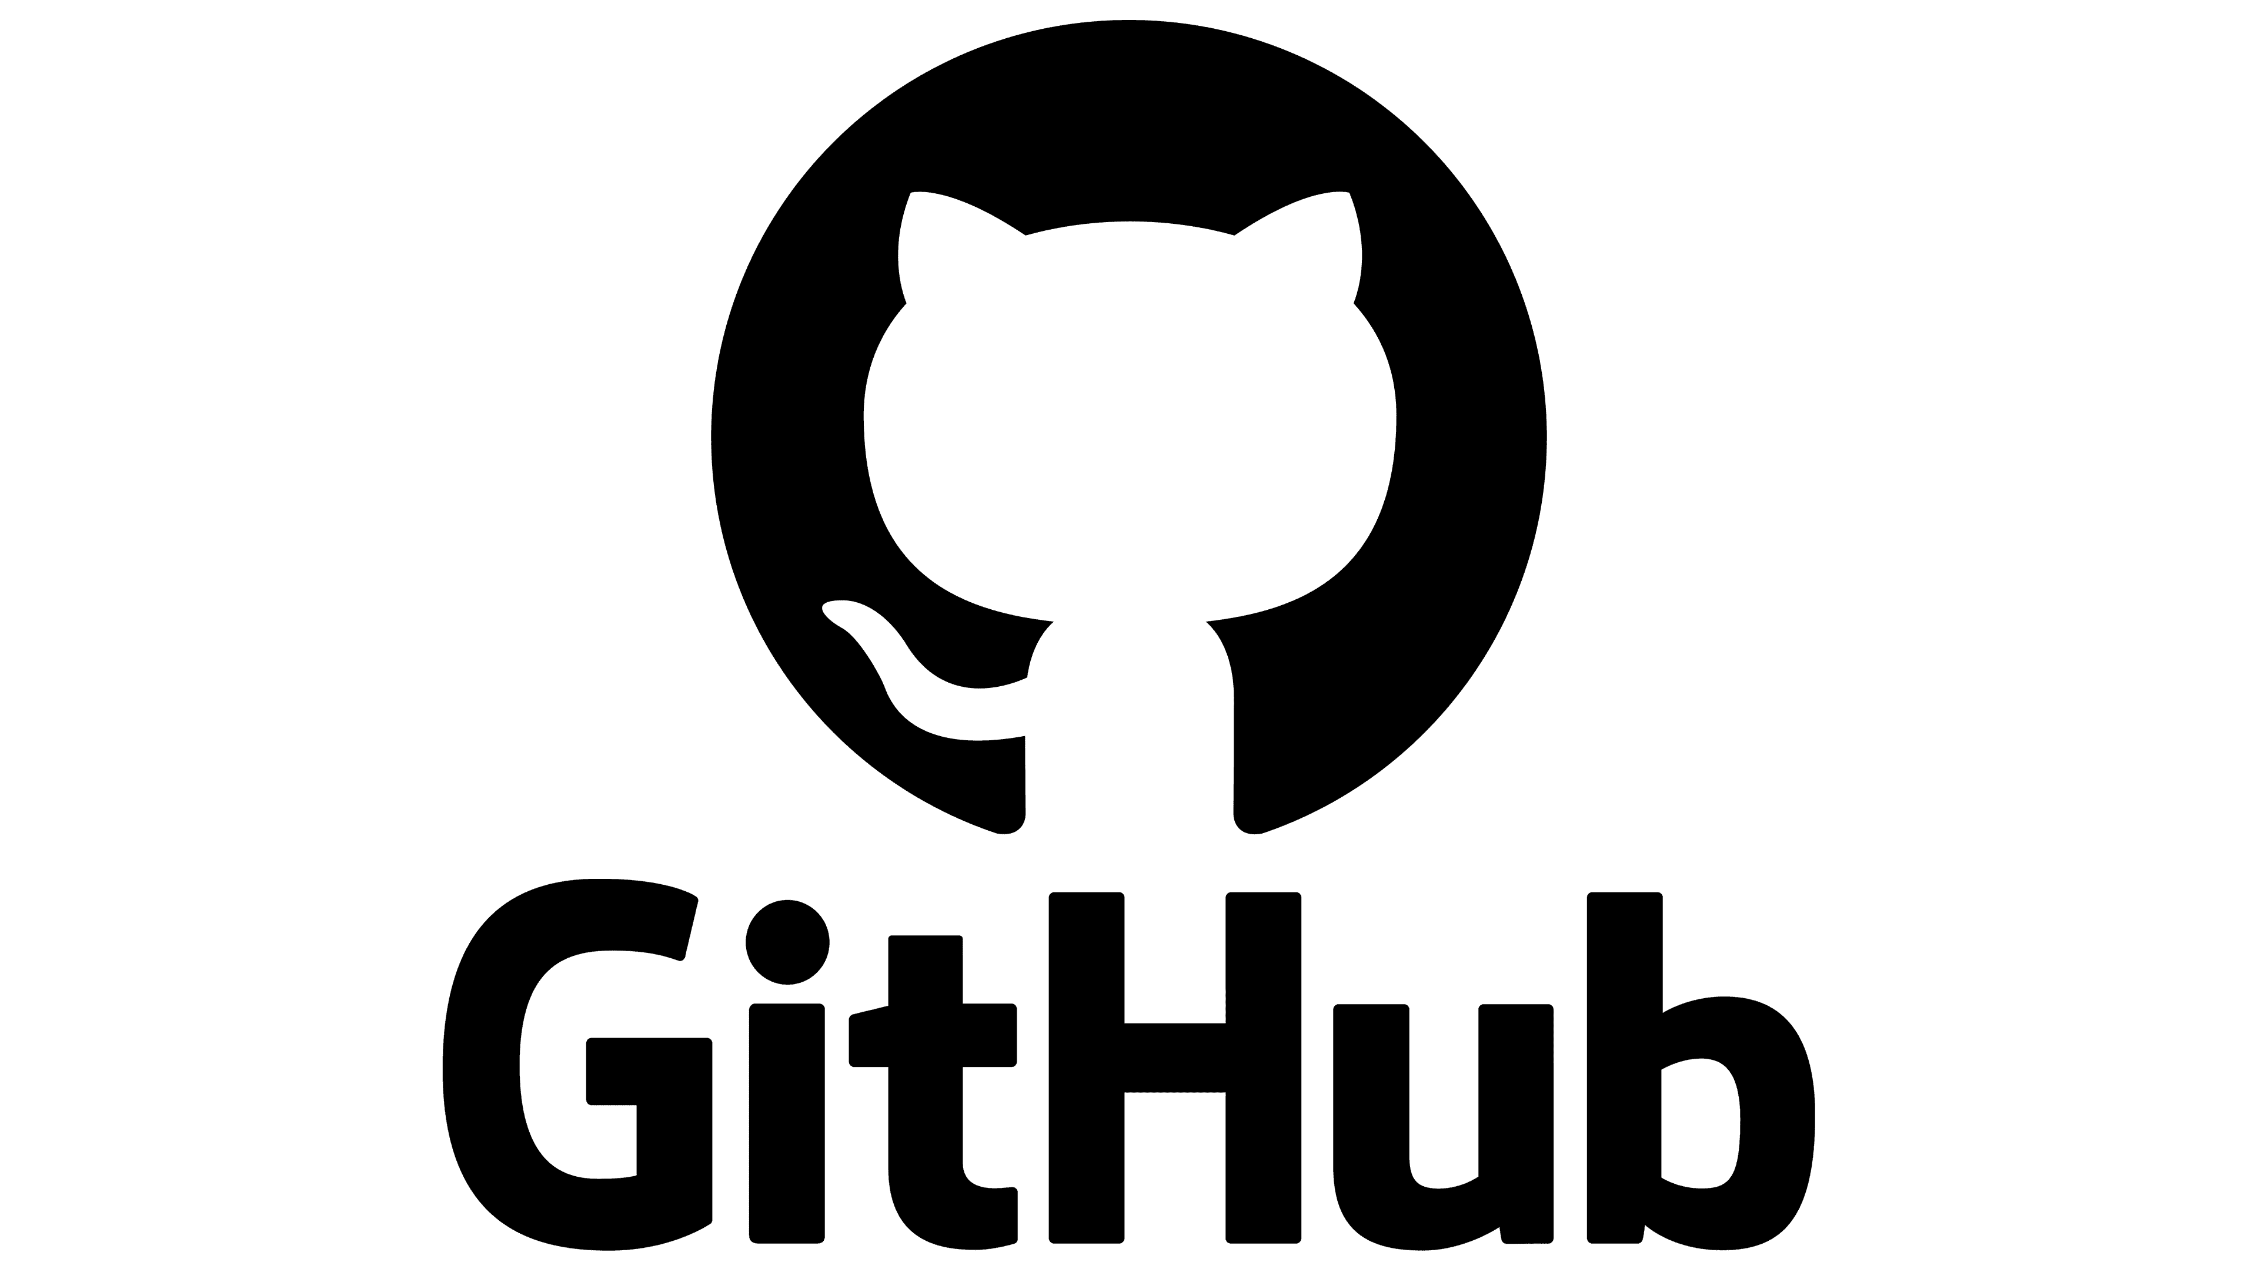



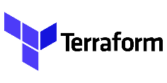
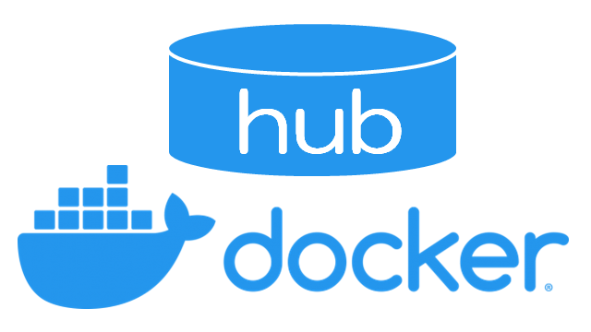

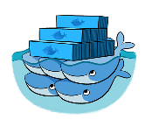

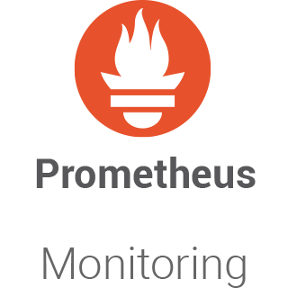
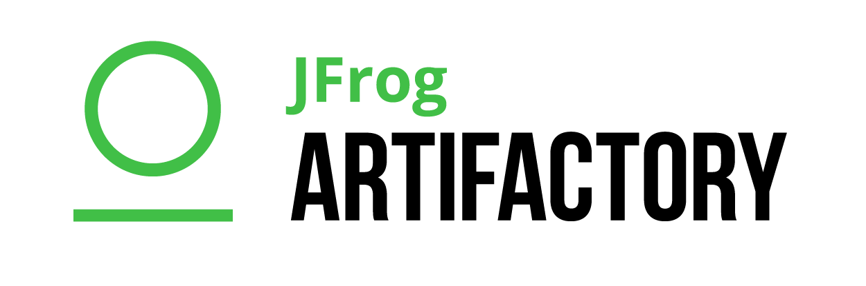
Technology Stack
INFRASTRUCTURE
SECURITY
Guard Duty
AWS Security Hub
GCP Cloud Armor
PROFESSIONAL SERVICES
& DIGITAL WORKPLACE
MANAGED SERVICES
Service Management | Monitoring | Optimization
DATA ANALYTICS & AI
Ingestion & ETL | Data warehousing | Business Intelligence
DEVOPS
SCM | Build | QA | Deploy | Config Mgmt. | Artefact Mgmt | Orchestration | Log & Monitor

Slide 5

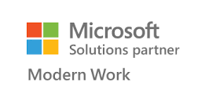
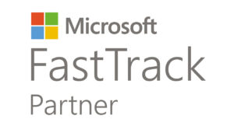
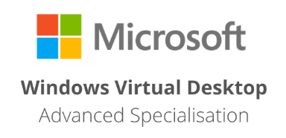
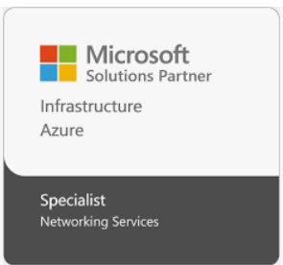
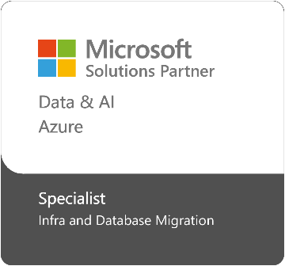
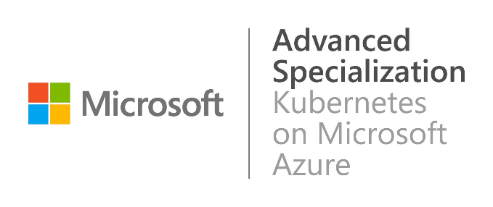
Redington's Cloud Competencies & Badges
Enables Resell & Consumption Business
Enables Professional Services
Program Enrolment - WIP
Data & AI
Infrastructure
Threat Protection
Digital & App Innovation
Security
Infra & Database Migration
70+
15+
AZURE Certified Individuals
DevOps Certified Individuals
20+
25+
Cloud Security Certified Individuals
M365 Certified Individuals

Slide 6
A
B
C
Discussion Key Points
How we can help you overcome the Challenges
Why Migrating to Azure makes sense
The Challenges you Might Face

Slide 7
A
B
C
Discussion Key Points
How we can help you Overcome the Challenges
Why Migrating to Azure makes sense
The Challenges you might Face

Slide 8









Your business has competing priorities
47%
Of SMBs say AI is their top forward-looking tech priorityI¹
Infuse AI
Budget and cost optimization
Cybersecurity threats
#1
organizational initiative²
77%
Of SMBs cite cloud security as a concern²
Datacenter contract expiry
Agility
to scale
90%
of organizations are impacted by IT skills shortage³
67%
Of SMBs see compliance as a top challenge ²
Sovereignty and compliance
Legacy applications or siloed databases
Faster time
to market
Resource and skilling constraints
IDC, 2025, SMB AI Adoption Journey
2. Flexera State Of The Cloud 2025
3. IT Skills Shortage Expected to Impact Nine out of Ten Organizations, IDC cited in Businesswire
1

Slide 9



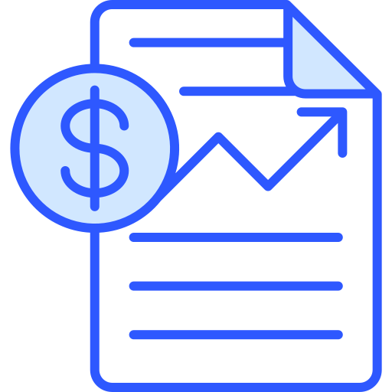
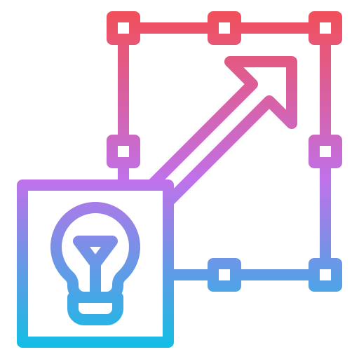

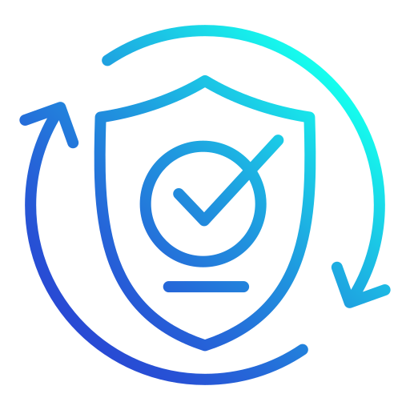
Legacy IT Infra & business challenges
Legacy IT Infra
High maintenance Costs & unpredictable Capital Expenses (CapEx)
Limited scalability & performance issues impacting growth
Organizations are operating with legacy IT, facing high operational costs, scalability challenges, and security risks
Security vulnerabilities in legacy systems
Compliance challenges with evolving regulations
Traditional IT models hinder business agility and digital transformation
Notes:
Enabling cloud agility is not a one-size fits all proposition.
We understand that every organization is unique, with its own set of requirements, skills, and datacenter investments.
That's why we provide a flexible approach to migration and give you cloud on your terms – whether it’s moving to Azure IaaS or PaaS,
Moving large VMware workloads to Azure VMware Solution, or extending Azure management and security to hybrid and multicloud environments through Azure Arc.
With this adaptive cloud approach - you get a consistent way to manage all your infrastructure and apps no matter where they reside.

Slide 10

The value of a strong cloud foundation
WITHOUT CLOUD
WITH CLOUD
AI challenges
Lack of access to models and compute power
AI-ready
Wide access to models, powerful compute for scale
Rigid and slow
Redundant, manual processes, lack of power
Agility
Deploy, build, scale, integrate fast
Future Innovation
Legacy apps and databases
Siloed databases, lack of integration, fragmented
Cloud-native
Managed services, unified databases
Non-compliant
Manual reporting, data residency complexity
Cloud
Sovereign and compliance
Keep up with local and global regulations
Prone to security threats
Large attack surface area, vulnerable
Protected
Continuous visibility, threat detection, resiliency
Pressing Priorities
Resource-constrained
Upskilling, employee turnover, talent retention
Optimized resources
Maximize skills, seamless collaboration
High costs
Upfront CapEx, underutilized resources
Financial efficiency
Only pay for what you use

Slide 11
Why migrate and modernize with Azure?
Azure offers a secure and scalable cloud platform that helps you modernize faster, grow efficiently, and access practical AI innovation, backed by Microsoft security expertise
Grow and adapt quickly with AI-powered solutions
Streamline your data for smarter AI
Maximize your security and compliance
Modernize with Azure for performance and efficiency
Modernize your apps and business with practical AI, and bring new business opportunities to market faster.
Unify your data in Azure to innovate faster and more securely. Get faster data availability, manage data privacy, and modernize to seamlessly integrate with AI models.
Secure every part of your business with Microsoft’s global expertise. Unify threat remediation across hybrid and multi-cloud environments; get broad and deep cloud security coverage.
Azure Accelerate offerings help you migrate and modernize to Azure. Azure Hybrid Benefit delivers savings for Windows and SQL Server customers.*
**Azure Hybrid Benefit for customers with Software Assurance. See aka.ms/ahb for details

Slide 12
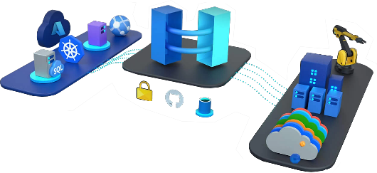
Azure Migrate and Modernize program
Future- Ready IT Strategy
End-to-End Migration & Modernization Assess, plan, and execute a seamless transition to Azure
Cost Optimization & ROI Acceleration Reduce infra costs by up to 40% with Azure Hybrid Benefits
Organizations need a future-ready IT strategy to remain competitive
Security & Compliance Assurance Get built-in zero-trust security and regulatory compliance
Application & Database Modernization Move from legacy to cloud-native, AI-driven apps
Q- How do we seamlessly migrate workloads without disrupting operations?
Q- What is the best approach to migrate, optimize, and modernize IT infrastructure?
Business Continuity & Disaster Recovery (BCDR) Ensure 99.99% uptime and resilience with multi-region failover
Notes:
Enabling cloud agility is not a one-size fits all proposition.
We understand that every organization is unique, with its own set of requirements, skills, and datacenter investments.
That's why we provide a flexible approach to migration and give you cloud on your terms – whether it’s moving to Azure IaaS or PaaS,
Moving large VMware workloads to Azure VMware Solution, or extending Azure management and security to hybrid and multicloud environments through Azure Arc.
With this adaptive cloud approach - you get a consistent way to manage all your infrastructure and apps no matter where they reside.

Slide 13




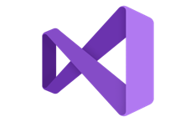










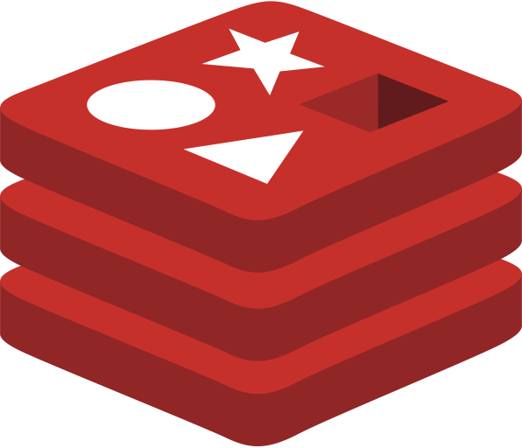
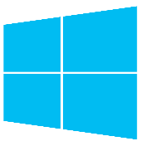







Azure is purpose-built for all your workloads
From first-party to open-source
AI models
Applications
Visual Studio
.NET
Java
Python
NetApp
Data
SQL
Server
PostgreSQL
MySQL
Microsoft
Fabric
Azure
Databricks
Snowflake
Oracle Database@Azure
MongoDB
Redis
GitHub
Infrastructure
Windows Server
Linux distributions
Kubernetes platforms
Leader in 6+ Gartner® Magic Quadrants™
Extensive native integrations with latest tools and technologies
Best-in-class cost and performance
Only cloud operated by a leading security vendor

Slide 14
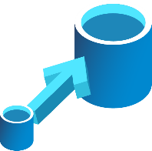

Why trust Azure for data migration and modernization?
25+ year Innovation
Seamless
Migration
Competitive TCO
Programmatic Support
Industry leading performance and security¹, with unmatched cloud scale
AI-enhanced tools for lift-and-shift migrations or modernizing existing applications
Higher performance, lower TCO. Pay up to 28% less than the alternatives.²
Free migration tools, POC/ trials with support from Microsoft through Azure Accelerate
Built-in hybrid
Operate hybrid seamlessly with integrated backup & disaster recovery
¹All Claims as of 2/20/2019.http://www.tpc.org/4081; http://www.tpc.org/3331; http://www.tpc.org/3329; http://www.tpc.org/3321; National Institute of Standards and Technology Comprehensive Vulnerability Database
²Price-performance claims are based on a May 2023 study commissioned by Microsoft and conducted by GigaOm. The study compared price performance between workloads on Red Hat Enterprise Linux 8.6 in Azure with Premium SSD v2 Managed Disks and Amazon Web Services on Red Hat Enterprise Linux 8.6 with General Purpose (gp3) volumes. Benchmark data is from the GigaOm Transactional Field Test, a subset of TPC Benchmark™ E (TPC-E).
4

Slide 15
B
C
D
A
Built-in Cost Optimization tools
Azure Migrate & Modernize
Migration Approach
Modernize Apps & Database
Security & compliance
Allows businesses to modernize applications and databases, unlocking AI, analytics, and automation capabilities
Azure ensures enterprise-grade security & compliance, reducing the risks associated with outdated infrastructure
offers built-in cost optimization tools to help you save up to 40% on infrastructure costs
Provides a step-by-step, structured migration approach, so you don’t have to worry about disruptions

Slide 16
A
B
C
D
Built-in Cost Optimization tools
Azure Migrate & Modernize
Migration Approach
Modernize Apps & Database
Security & compliance
Allows businesses to modernize applications and databases, unlocking AI, analytics, and automation capabilities
Azure ensures enterprise-grade security & compliance, reducing the risks associated with outdated infrastructure
offers built-in cost optimization tools to help you save up to 40% on infrastructure costs
Provides a step-by-step, structured migration approach, so you don’t have to worry about disruptions

Slide 17
A
B
C
D
Migration Approach
Built-in Cost Optimization tools
Modernize Apps & Database
Security & compliance
Azure Migrate & Modernize
Allows businesses to modernize applications and databases, unlocking AI, analytics, and automation capabilities
Azure ensures enterprise-grade security & compliance, reducing the risks associated with outdated infrastructure
Provides a step-by-step, structured migration approach, so you don’t have to worry about disruptions
offers built-in cost optimization tools to help you save up to 40% on infrastructure costs

Slide 18
A
B
C
D
Migration Approach
Built-in Cost Optimization tools
Modernize Apps & Database
Security & compliance
Azure Migrate & Modernize
Allows businesses to modernize applications and databases, unlocking AI, analytics, and automation capabilities
Azure ensures enterprise-grade security & compliance, reducing the risks associated with outdated infrastructure
Provides a step-by-step, structured migration approach, so you don’t have to worry about disruptions
offers built-in cost optimization tools to help you save up to 40% on infrastructure costs

Slide 19
A
B
C
D
Migration Approach
Built-in Cost Optimization tools
Security & compliance
Modernize Apps & Database
Azure Migrate & Modernize
Azure ensures enterprise-grade security & compliance, reducing the risks associated with outdated infrastructure
Allows businesses to modernize applications and databases, unlocking AI, analytics, and automation capabilities
Provides a step-by-step, structured migration approach, so you don’t have to worry about disruptions
offers built-in cost optimization tools to help you save up to 40% on infrastructure costs

Slide 20
Support you @ Every Stage of Cloud Adoption
Discover & Assess the environment
Assessment for Rapid Migration to Azure
TCO Analysis
Detailed Reports
SAP Migration Assessment
Assessment to Modernize
Infra and Database Migration
SAP Migration
Virtual Desktop Infrastructure
Migrating to Azure VMWare Solution
Migrate Enterprise Apps
Proactive monitoring
Ticket Management System
Security Management
Effective SLA response time
Best practices recommendations
Change Management
Patch Management
Utilization Monitoring
Monitoring performance efficiency
Configuration of Alerts
Re-engineering
Implement new features and services
Improve the cost visibility
Fine-tuning of sizing, elasticity, and backups
ASSESS
MIGRATE & MODERNIZE
OPERATE
OPTIMIZE
Secure : Establish security baseline and manage security posture
Expert & Microsoft Certified Resources
Workshops to Build Customer Intent
Solutions Assessment
POC to Gain Customer Confidence
Program Benefits

Slide 21




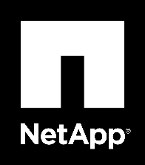

Maximum ROI and performance for all workloads
Windows Server and SQL Server
Linux and open-source
Strategic partnerships
80%
cost savings¹
5x
faster²
Achieve 192% ROI over 3-years with Red Hat Enterprise Linux (RHEL) on Azure³
Only cloud provider to run Oracle Cloud Infrastructure
vs. AWS
IDC Business Value White Paper, sponsored by Microsoft Azure, The Business Value of Microsoft Azure for SQL Server and Windows Server Workloads, doc #US49616022, September 202
Microsoft Azure SQL Managed Instance benchmark vs. AWS RDS for SQL Server using Azure Hybrid Benefit pricing, May 2022. Comparison also shows that SQL runs up to 5x faster.
Notes:
Azure is a purpose-built for all workloads, so you can be confident that you get maximum ROI and performance for all your workloads.
Starting with Windows Server and SQL Server, you can get up to 80% cost-savings with Azure Hybrid Benefit and free Extended Security Updates for end of support workloads and up to 5x faster performance of SQL Server on Azure versus other providers!
And it’s not just Windows Server and SQL Server, we also provide a purpose-built platform for Linux and open-source software! A recent study showed that you can get up to 192% ROI over 3 years by running RedHat on Azure!
And last but not least, we also have strategic partnerships and native integrations for your largest third-party workloads such as SAP, VMware, and Oracle – so you can be confident that those workloads are also optimized to run efficiently on Azure.
For example, we’re the only cloud provider that has a partnership with Oracle to run OCI workloads in Azure datacenters! And with SAP, we offer 139 SAP-certified virtual machines for HANA, significantly more than any other provider so you can dial in the right scale and performance needed for your SAP systems.

Slide 22
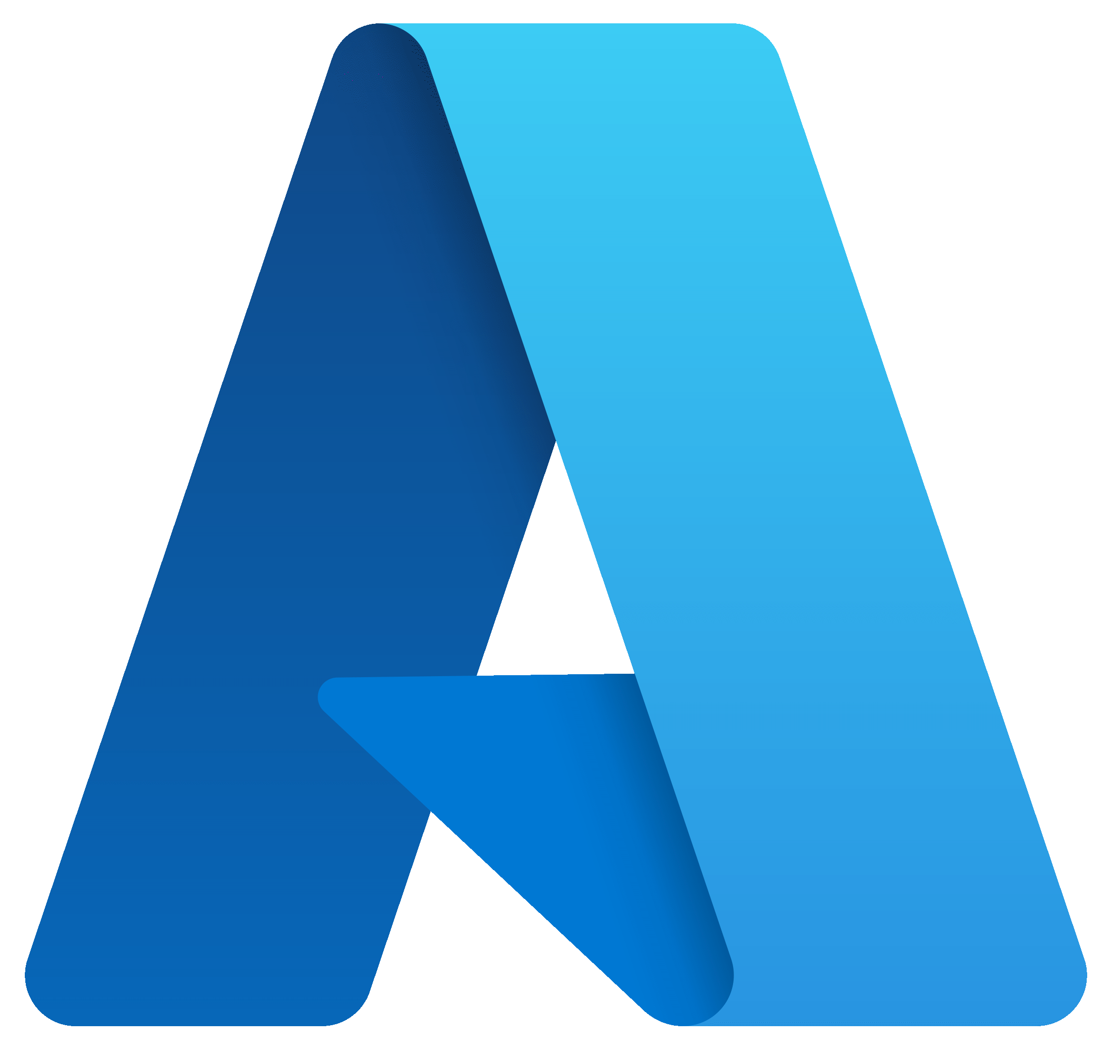

Get expert help and guidance with Azure Migrate and Modernize
Azure meets you where you are with an adaptive cloud approach
Migrate apps, data, and infra
Move VMware as is
Extend to hybrid multi-cloud, and edge
Easily migrate to IaaS or flexible PaaS services for industry-leading performance, availability, and reliability
Azure VMware Solution allows you to use VMware technology stack and team expertise in Azure.
Unify siloed teams, distributed sites, and sprawling systems into a single operations, security, application, and data model with Azure Arc
Notes:
Enabling cloud agility is not a one-size fits all proposition.
We understand that every organization is unique, with its own set of requirements, skills, and datacenter investments.
That's why we provide a flexible approach to migration and give you cloud on your terms – whether it’s moving to Azure IaaS or PaaS,
Moving large VMware workloads to Azure VMware Solution, or extending Azure management and security to hybrid and multicloud environments through Azure Arc.
With this adaptive cloud approach - you get a consistent way to manage all your infrastructure and apps no matter where they reside.

Slide 23
Azure Accelerate – Program Benefits
Customer’s Benefits
Free Assessment
Azure Costing (BOQ)
Assessment / Pre Sales
Let’s define a strategy and desired outcomes using Microsoft Cloud Adoption Framework
Scope of Work
Migration / Deployment workloads & how they can securely move to the cloud with Azure Migrate
Architecture & Proposal
Security Best Practices
Roadmap & Action Plan
Free Migration

Slide 24
Azure Migrate & Modernize - Process - Workflow
End Customer should acknowledge the AMM engagement, received in their Email ID by
microsoft-noreply@microsoft.com
Assessment Migration
Redington/Partner performs the Assessment of customers infrastructure using Azure migrate.
Azure migrate assessment report is reviewed with the customer.
Redington/Partner performs the migration of customers infrastructure to Azure.
Redington registers the opportunity with Microsoft as AMM Opportunities.
Customer provides the acknowledgement for the assessment/Migration
Customer provide the Sign off for the project completion
Customer complete the survey about the overall engagement.
Nomination
Sign Off

Slide 25
Next steps
Strategy workshop
Let’s define a strategy and desired outcomes using Microsoft Cloud Adoption Framework
Azure Migrate assessment
Assess workloads & how they can securely move to the cloud with Azure Migrate
Pilot & proof of concept
Gain confidence and see technical proof
Azure Migrate and Modernize
Securely move your workload to the cloud with confidence, proven best practices & incentives to accelerate your migration
Invent with purpose.

Slide 26

Thank You
Copyright 2024 Redington India- All rights Reserved

